Slide 1
Shape of the distribution
Md. Ismail Hossain Riday

Slide 2
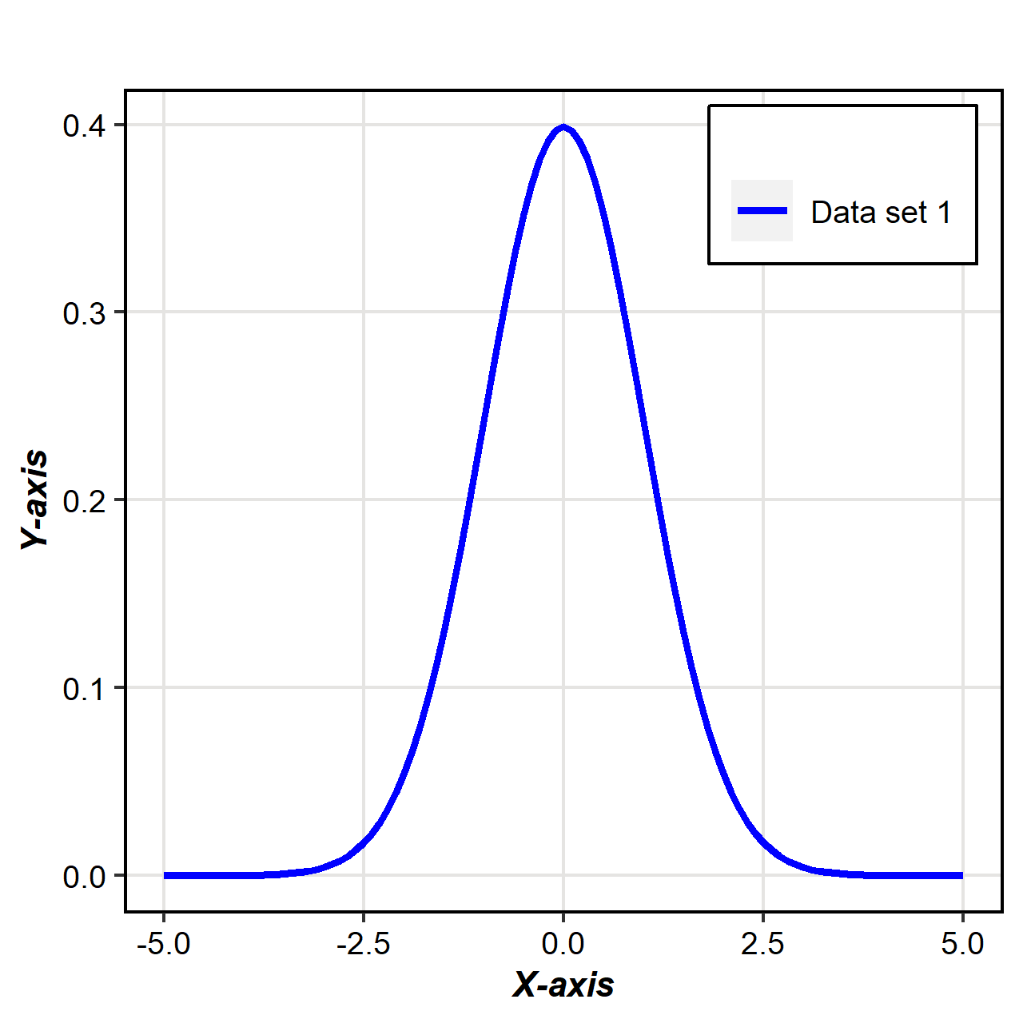
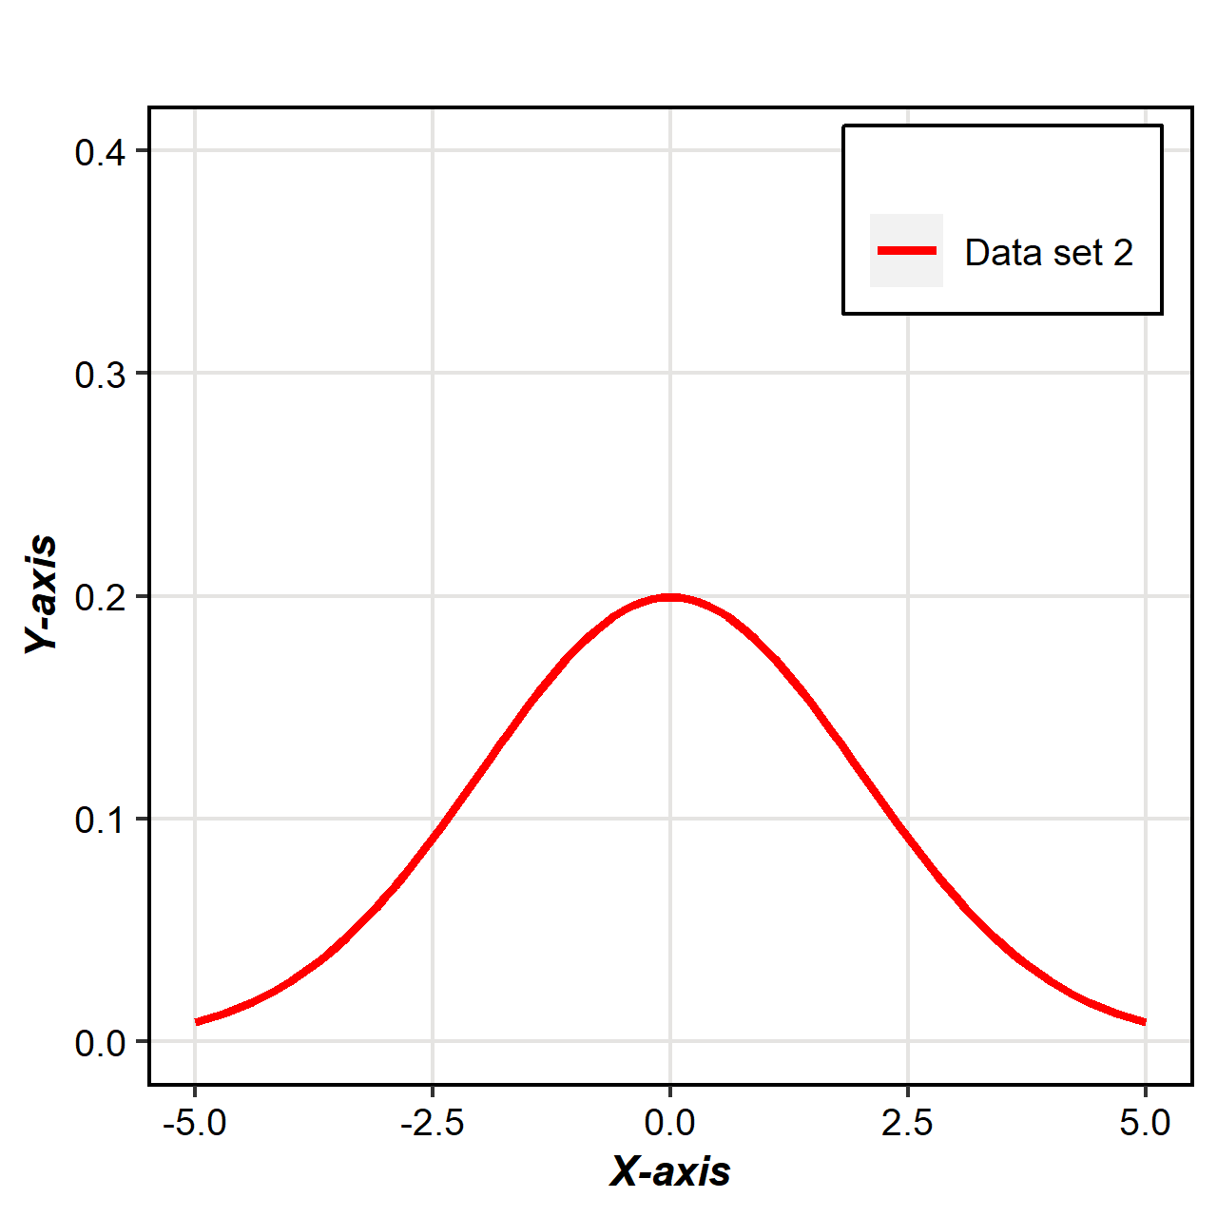
Shape of the distribution
In previous chapter, we learned about “Location” and “Dispersion” which are two important quantitative concepts.
Two data sets may have identical means and identical variance, but their graphical shapes may be different
Mean & Variance fail to describe the shape of the data distribution
Mean & Variance fail to describe the shape of the data distribution

Slide 3
Moments
Moments are constant
Which used to determine some characteristics/properties of frequency distribution

Slide 4
Moments
Moments are constant
Which used to determine some characteristics/properties of frequency distribution
Skewness

Slide 5
Moments
Moments are constant
Which used to determine some characteristics/properties of frequency distribution
Skewness
Kurtosis
Shape of the distribution

Slide 6


Moments
$r^{th}$ moments can be written as,
$μ_{r}=\frac{\sum{{\left(X_{i}−\overline{X}\right)}^{r}}}{N} ;r=1,2,3,4,…$
$If r=1, μ_{1}=First moment=\frac{\sum{{\left(X_{i}−\overline{X}\right)}^{1}}}{N}$
$If r=2, μ_{2}=Second moment=\frac{\sum{{\left(X_{i}−\overline{X}\right)}^{2}}}{N}$
$If r=3, μ_{3}=Third moment=\frac{\sum{{\left(X_{i}−\overline{X}\right)}^{3}}}{N}$
$If r=4, μ_{4}=Fourth moment=\frac{\sum{{\left(X_{i}−\overline{X}\right)}^{4}}}{N}$

Slide 7
Skewness
Lack of symmetry of a distribution

Slide 8
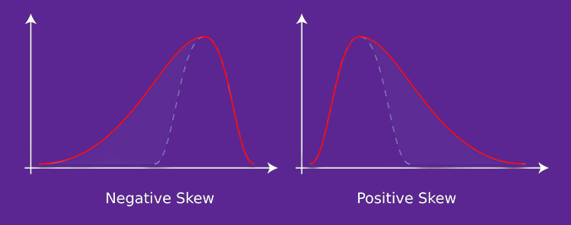
Skewness
Symmetrical distribution
Lack of symmetry of a distribution
Deviation from symmetrical distribution
Lack of symmetry

Slide 9
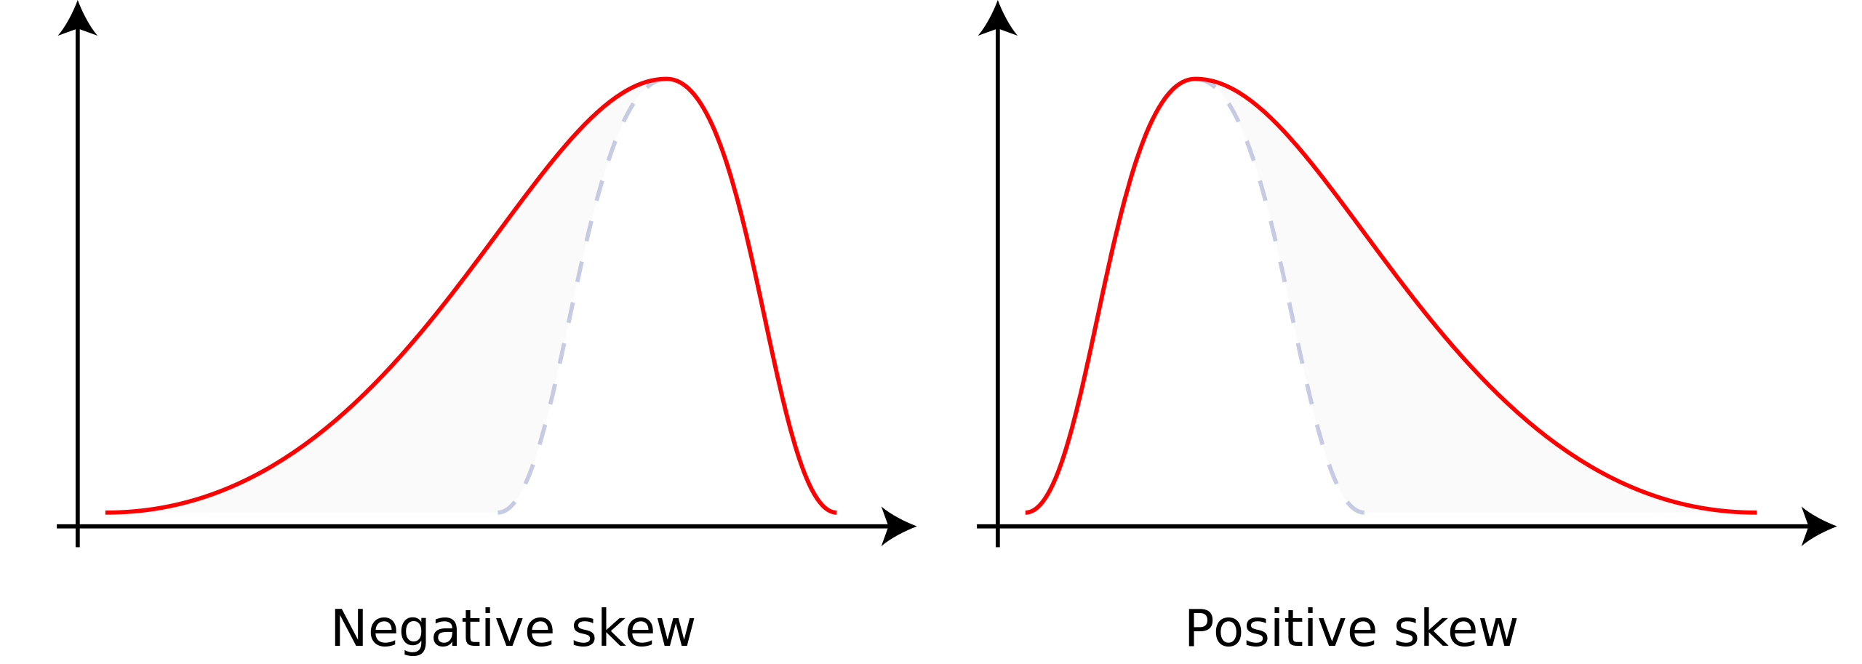
Types of skewness
There are two types of skewness or lack of symmetry occurs:
Positive skewness
Negative skewness

Slide 10
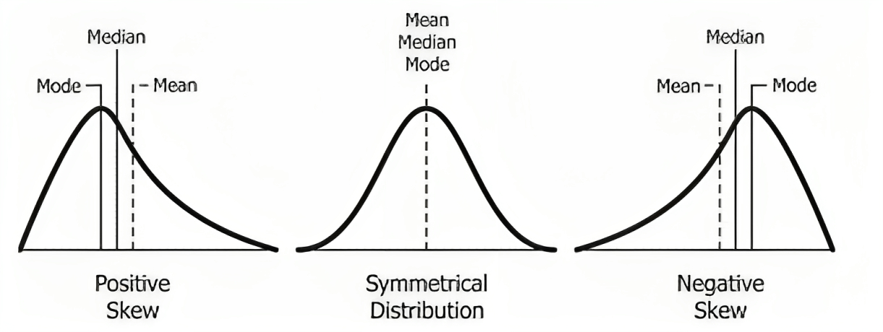


Graph
$$Mean>Median>Mode$$
$$Mean<Median<Mode$$

Slide 11

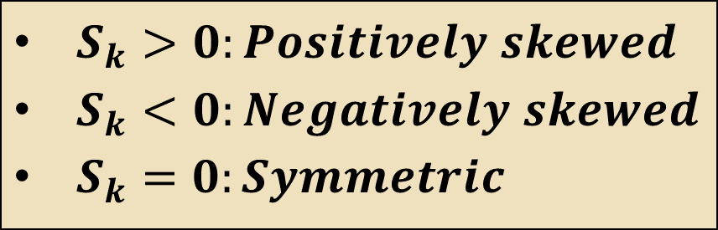
Coefficient of skewness
For example: Calculate the coefficient of skewness: 15,18,2,6,4
$S_{k}=\frac{3(Mean−Median)}{Standard Deviation}$
$S_{k}>0:Positively skewed$
$S_{k}<0:Negatively skewed$
$S_{k}=0:Symmetric$
$$Mean−Mode=3(Mean−Median)$$

Slide 12
Coefficient of skewness
For example: Calculate the coefficient of skewness: 15,18,2,6,4
Mean = 9
$S_{k}=\frac{3(Mean−Median)}{Standard Deviation}$
$S_{k}>0:Positively skewed$
$S_{k}<0:Negatively skewed$
$S_{k}=0:Symmetric$

Slide 13
Coefficient of skewness
For example: Calculate the coefficient of skewness: 15,18,2,6,4
Mean = 9
Median = 6
$S_{k}=\frac{3(Mean−Median)}{Standard Deviation}$
$S_{k}>0:Positively skewed$
$S_{k}<0:Negatively skewed$
$S_{k}=0:Symmetric$

Slide 14
Coefficient of skewness
For example: Calculate the coefficient of skewness: 15,18,2,6,4
Mean = 9
Median = 6
SD = 7.07
$S_{k}=\frac{3(Mean−Median)}{Standard Deviation}$
$S_{k}>0:Positively skewed$
$S_{k}<0:Negatively skewed$
$S_{k}=0:Symmetric$

Slide 15

Coefficient of skewness
For example: Calculate the coefficient of skewness: 15,18,2,6,4
Mean = 9
Median = 6
SD = 7.07
$$S_{k}=\frac{3(Mean−Median)}{SD}=\frac{3\left(9−6\right)}{7.07}=1.27$$
$S_{k}=\frac{3(Mean−Median)}{Standard Deviation}$
$S_{k}>0:Positively skewed$
$S_{k}<0:Negatively skewed$
$S_{k}=0:Symmetric$

Slide 16

Coefficient of skewness
For example: Calculate the coefficient of skewness: 15,18,2,6,4
Mean = 9
Median = 6
SD = 7.07
$$S_{k}=\frac{3(Mean−Median)}{SD}=\frac{3\left(9−6\right)}{7.07}=1.27$$
Since $S_{k}>0$, thus the distribution is positively skewed distribution.
$S_{k}=\frac{3(Mean−Median)}{Standard Deviation}$
$S_{k}>0:Positively skewed$
$S_{k}<0:Negatively skewed$
$S_{k}=0:Symmetric$

Slide 17
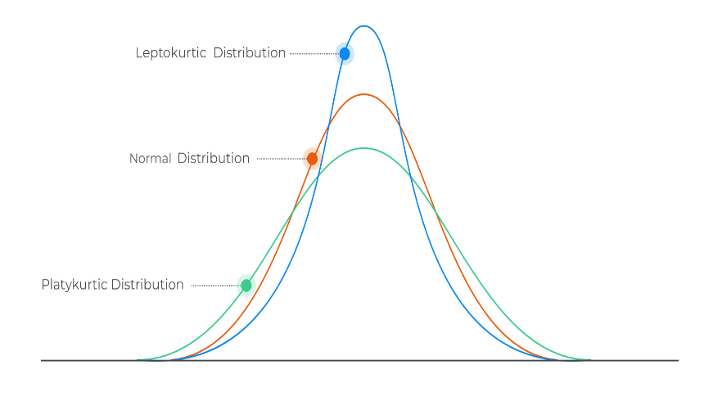
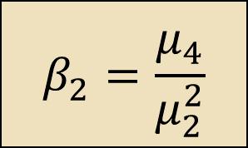




Kurtosis
$If r=1, μ_{1}=First moment=\frac{\sum{{\left(X_{i}−\overline{X}\right)}^{1}}}{N}$
$If r=2, μ_{2}=Second moment=\frac{\sum{{\left(X_{i}−\overline{X}\right)}^{2}}}{N}$
$If r=3, μ_{3}=Third moment=\frac{\sum{{\left(X_{i}−\overline{X}\right)}^{3}}}{N}$
$If r=4, μ_{4}=Fourth moment=\frac{\sum{{\left(X_{i}−\overline{X}\right)}^{4}}}{N}$
Degree of peaked or flatness of a distribution
Three types-
Leptokurtic
Mesokurtic/Normal
Platykurtic
$$β_{2}>3$$
$$β_{2}=3$$
$$β_{2}<3$$
$$β_{2}=\frac{μ_{4}}{μ_{2}^{2}}$$

Slide 18
Box & Whisker plot
A box-whisker plot, also known as a box plot, is a graphical representation of the distribution of a dataset.
It displays the five-number summary of the data:
Minimum value
First Quartile (Q1)
Second Quartile/Median (Q2)
Third Quartile (Q3)
Maximum value

Slide 19
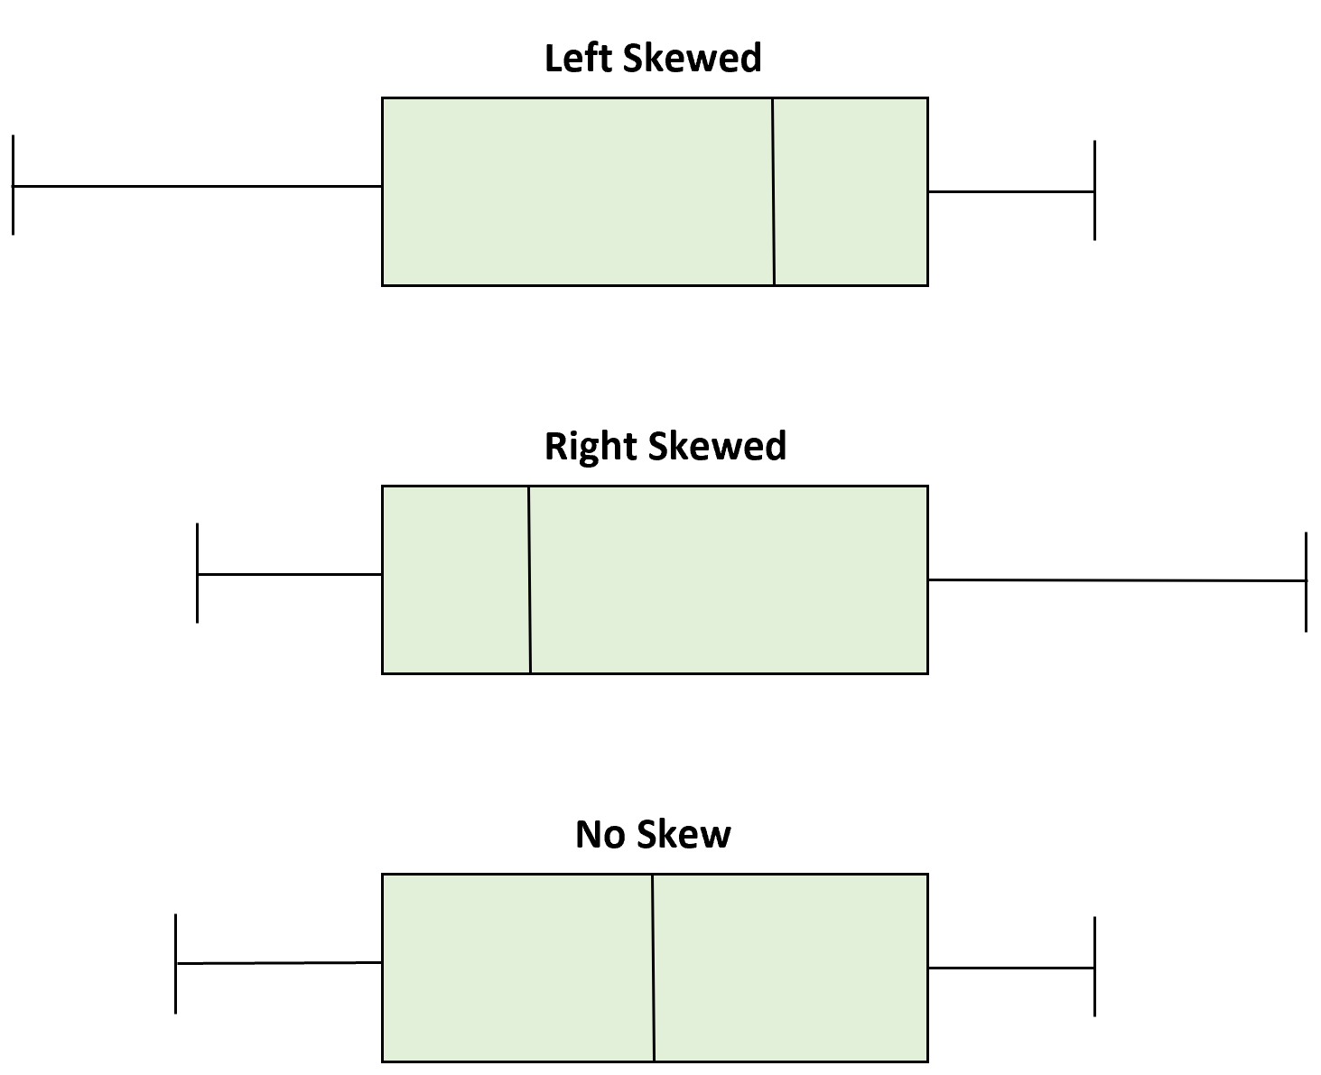
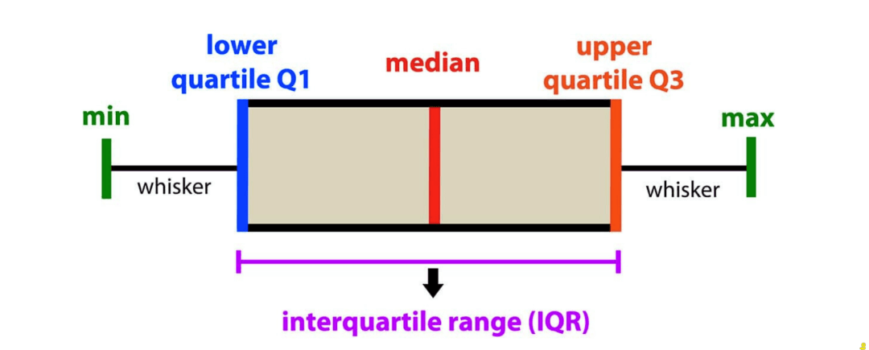
Importance of Box plot
To get idea of the shape of the distribution
To detect outliers from the data.

Slide 20
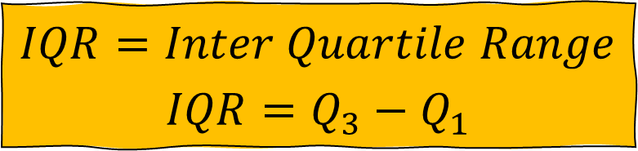

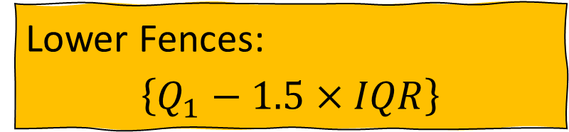
Identify outliers from boxplot
$$IQR=Inter Quartile Range$$
$$IQR=Q_{3}−Q_{1}$$
Lower Fences:
$$\left\{Q_{1}−1.5×IQR\right\}$$
Upper Fences:
$$\left\{Q_{3}+1.5×IQR\right\}$$

Slide 21
Identify outliers from boxplot
2900, 2765, 2960, 2890, 2880, 2720, 2930, 2950, 2860, 3060, 3260, 3525
Draw the box-whisker plot and detect the outlier(s)
Organize the data into ascending order,
2720, 2765, 2860, 2880, 2890, 2900, 2930, 2950, 2960, 3060, 3260, 3525
Now,
Min=2720
Q1=2870
Q2=2915
Q3=3010
Max=3525
Min
Q1
Q2
Q3
Max

Slide 22
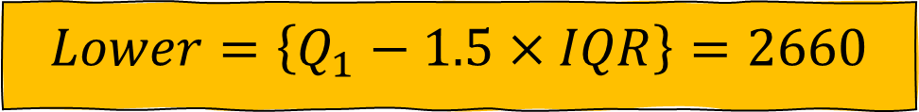


Identify outliers from boxplot
2720, 2765, 2860, 2880, 2890, 2900, 2930, 2950, 2960, 3060, 3260, 3525
Draw the box-whisker plot and detect the outlier(s)
Adjacent Max=3060
$$∴IQR=Q_{3}−Q_{1}=140$$
$$Lower=\left\{Q_{1}−1.5×IQR\right\}=2660$$
*
*
$$Upper=\left\{Q_{3}+1.5×IQR\right\}=3220$$
Min
Q1
Q2
Q3

Slide 23

Some points…
$Mean Deviation= \frac{4 }{5} Standard deviation$
$Quartile Deviation= \frac{2 }{3} Standard deviation$

Slide 24
Thank You

